Slide 1

B e s t B id s
By-
Kartik Rai (18074008)
Samyak Jain (18074015)
Shikhar Sharma (18074016)

Slide 2

Index
Introduction
Requirements Database Design
Project Structure Functionalities
Mapping
Use of middleware in the project
Use of syndication in the project
Additional Technologies used in the project References

Slide 3
Introduction
Best Bids is a bidding site that facilitates consumer to consumer sales through website. Every consumer can put up his product for auction and can bid on products listed by other users.

Slide 4
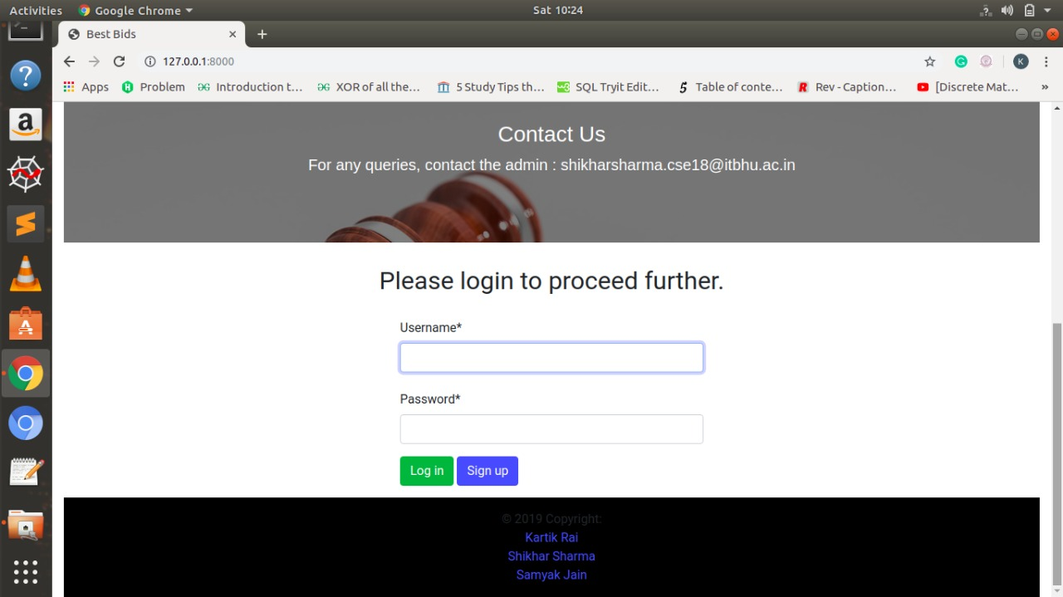

Slide 5
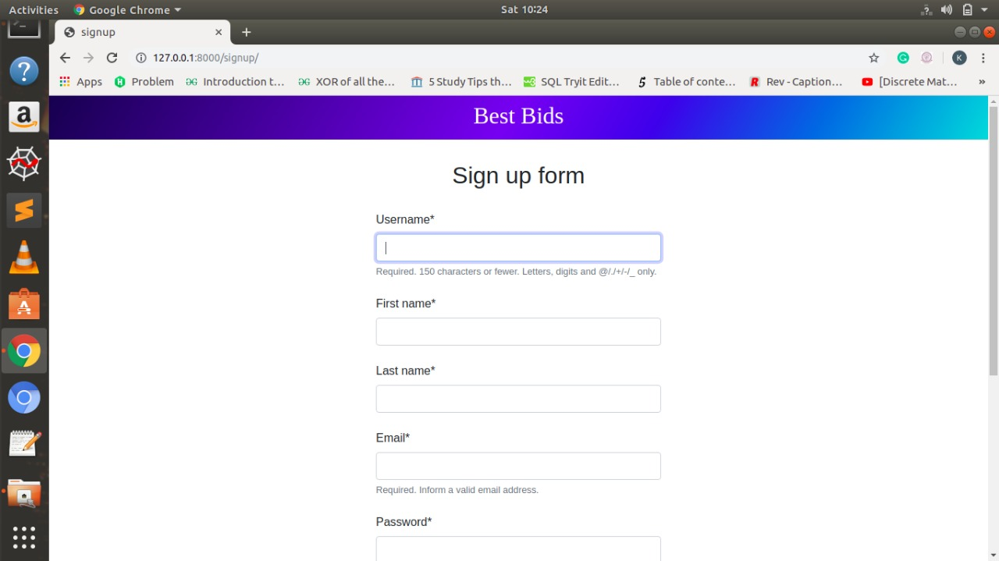

Slide 6
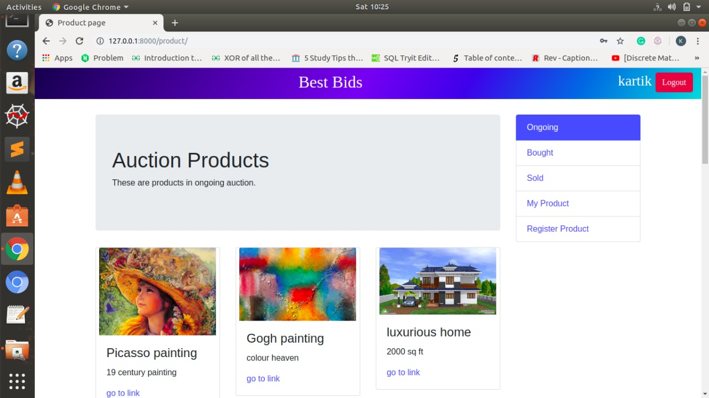

Slide 7
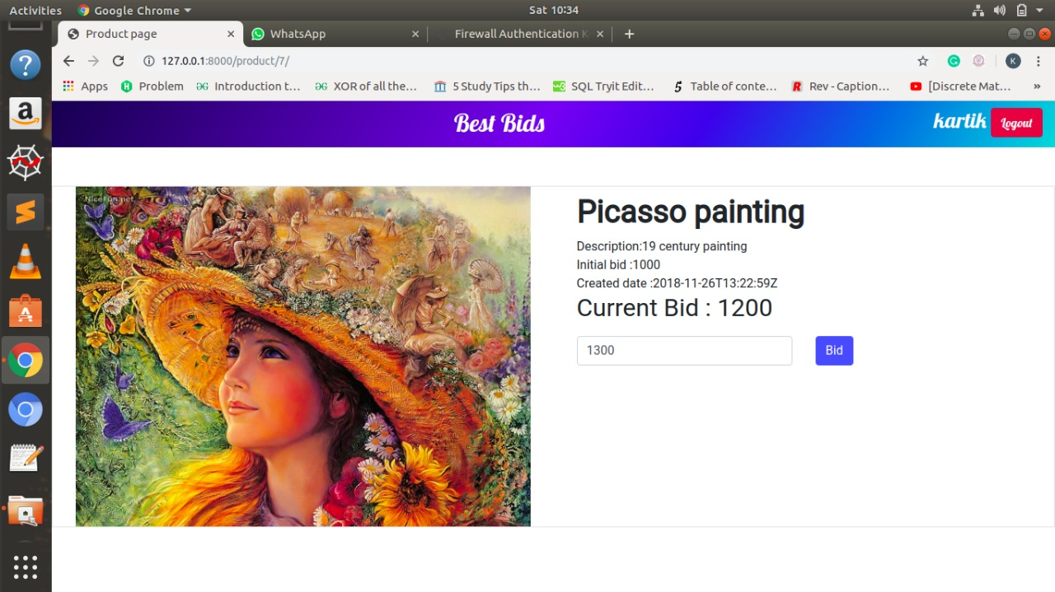

Slide 8
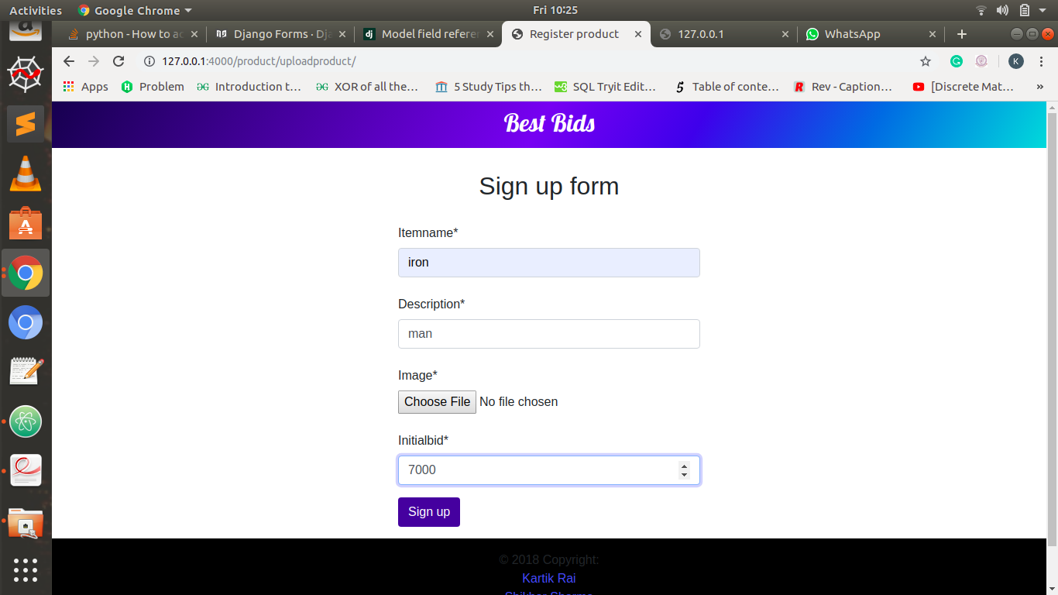
//This is register product page for adding new item to the auction.

Slide 9
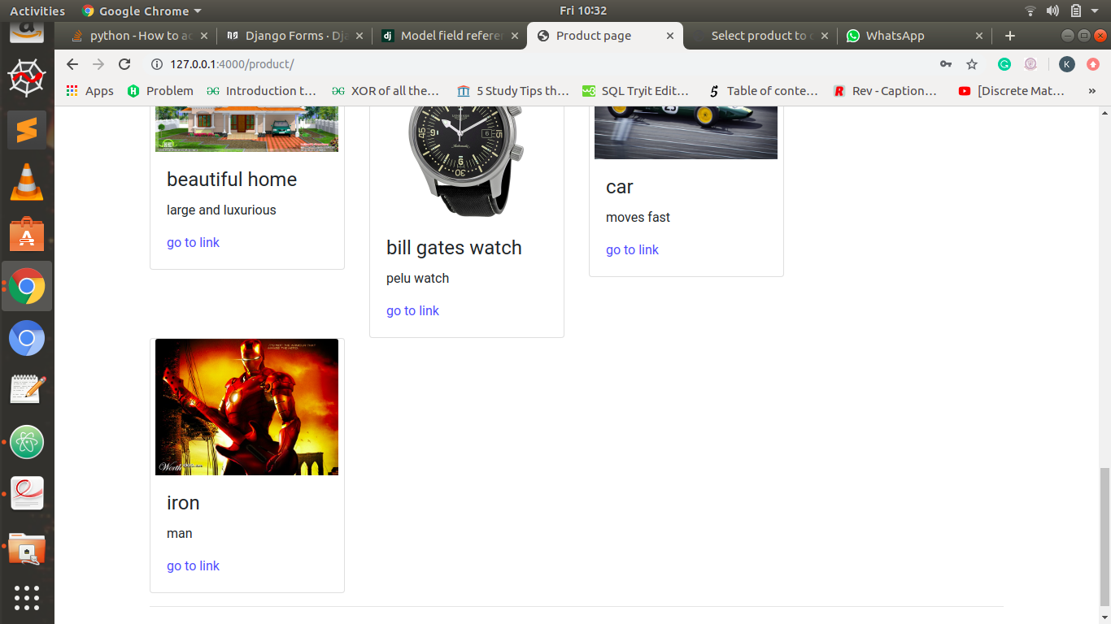

Slide 10
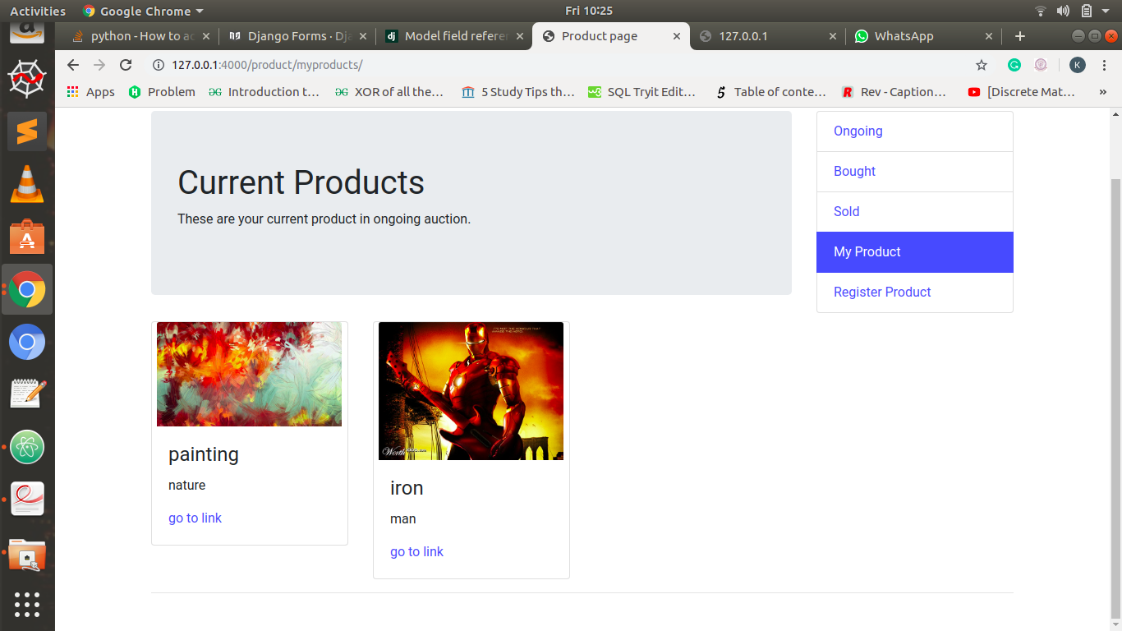

Slide 11
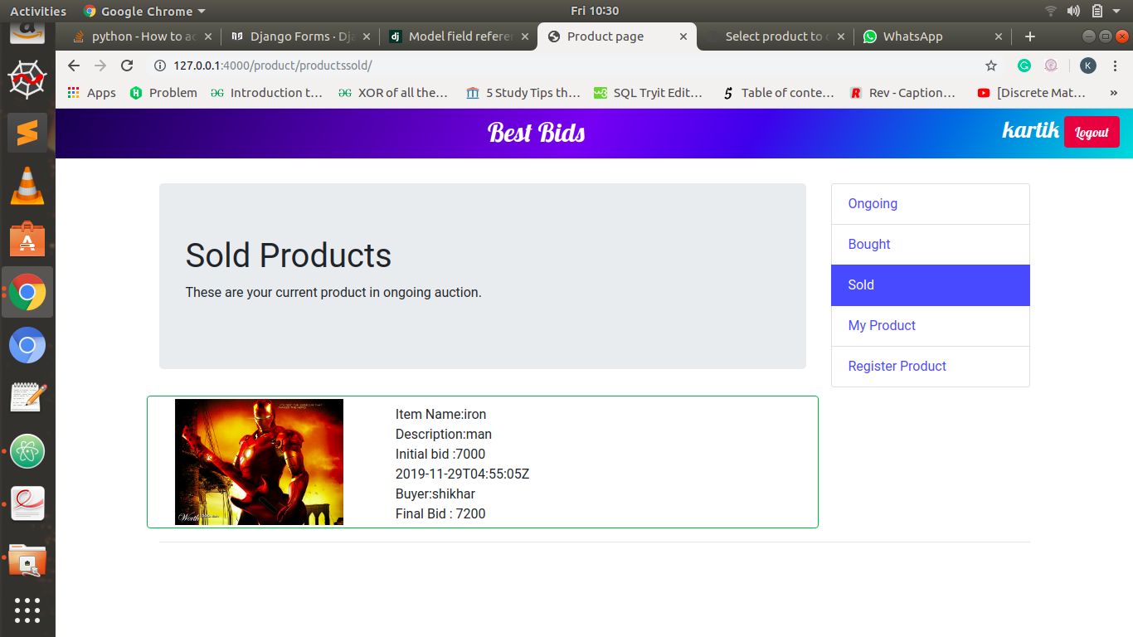
//The item which was uploaded is now sold.

Slide 12

What our project is able to do .
This project is Django based application.
User can signup and then login very easily to use the site.
User can view all the products he has put on auction and can also
see all the items he has bought through auction.
He can also see t he list products he has sold and has freedom to list items for bidding.
User with admin control has power to delete user, products.

Slide 13


Requirements
Django==2.0.6
django-crispy- forms==1.7.2
django-filter==2.0.0
djangorestframework== 3.8.2
Pillow==5.2.0

Slide 14

Database design
Relational Schema
We have majorly used two tables in our project and has implemented it using models.
The tables are
user.
productpage_product.

Slide 15

Attributes
are-
ID This is a unique number for every
user.
Password
is_superuser -if yes it gives the user
administrative control to add or delete products.
User name
First_name
Email
last_name
1 . USER

Slide 16

User
Id- integer NOT NULL PRIMARY KEY AUTOINCREMENT
Password- varchar (128) NOT NULL
is_superuser- bool NOT NULL
Username- varchar (150) NOT NULL UNIQUE
First_name- varchar (150) NOT NULL
Last_name- varchar (150) NOT NULL
Email- varchar (254) NOT NULL

Slide 17
At tributes used
are-
Id unique number for every product
regis tered on s ite .
Itemname .
Descript ion .
Image .
Init ial bid .
Cr eated date .
Status-Whether the product is on auction is already sold.
Buyer .
Bid .
Ownerid –The id of user. Same as id in table user.
2. PRODUCT PAGE_PRODUCT

Slide 18
productpage_product
Id- integer NOT NULL PRIMARY KEY AUTOINCREMENT
Itemname- varchar (200) NOT NULL
Description- varchar (200) NOT NULL
Image- varchar (200) NOT NULL
Initial bid- integer NOT NULL
Created date- datetime NOT NULL
Status- integer NOT NULL
Buyer- varchar (200) NOT NULL
Bid- integer NOT NULL
owner id- integer NOT NULL

Slide 19
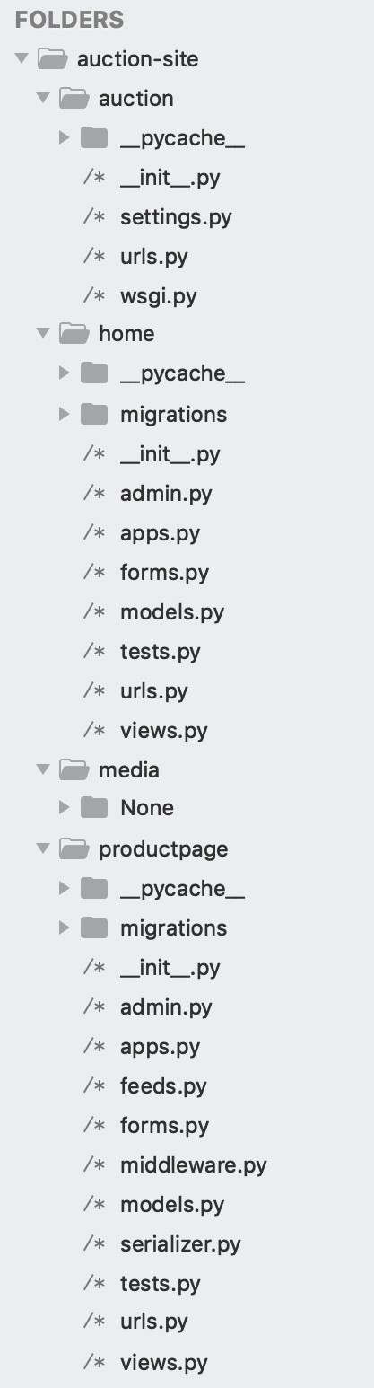
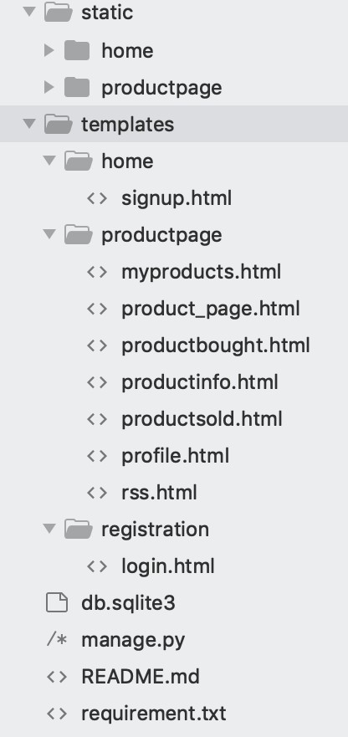
P r o j e c t s t r u c t u r e
The project name is auction.
All the images of the products are stored in media folder.
There are two apps in the project.
Home.
Product page.

Slide 20

Functionalities
One of the app is home. This app just handles the login and the signup pages. It is used to render the html pages of login and signup along with css.
The other app is product page. This is the main app which handles all the backend processes of the site.

Slide 21

Product page app
Functions in views.p y
profile- This function renders the html page “productprofile/profile.html”.
products- This function renders the html page “product_page.html” which displays all the products which are currently in auction.
getmyproduct- This function renders the html page “myproducts.html” which displays all the products that are registered by the user currently logged in.
productsold- This function renders the html page “productsold.html” which displays all the products sold by the user currently logged in.
productbought- This function renders the html page “productbought” which display all the products bought by the user currently logged in.

Slide 22
Product page app
F u n c t i o n s i n v i e w s . p y
model_from_upload- This function helps the user to upload the product.
newsfeed- used to render html page “rss.html” which displays the rss feed.

Slide 23
Mapping in product page app .
‘ ‘- calls products function in views which displays all the product listed for auction.
‘myproducts’- calls getmyproduct function in views which displays products that are listed by the current user.
‘productsold’- calls productssold function in views which displays products that are sold by the current user.
‘productsbought’- calls productbought function in views.py which displays products that are bought by the current user.
‘uploadproduct’- calls the function model_from_upload in views.py which allows the user to register the product on the site.
‘newsfeed’- calls the function newsfeed which displays RSS feed.

Slide 24
Use of middleware in the project .
The custom middleware used in the project is a very simple middleware which on request display the message “middleware is working” in the terminal. And on response it displays the message “it’s working again” in the terminal.

Slide 25
Addition technologies used in the project .
API’s has been used for fonts and colours of text and other UI.
Bootstrap is also used.

Slide 26
References
Django Girls tutorial.
Tango with Django book.
Django docs.
Python docs.
Django-rest framework.

Slide 27
We are open for suggestions for the website.

